Slide 1



Department of Computer Science and Engineering
ACADEMIC PROJECT
Smart Baby Monitoring System Using YOLO V8 Algorithm
TEAM NO:19C57
PRESENTED BY: GUIDED BY
Dr.T.ARUN KUMAR
SANJEEV S 19CSR171
SANJITH M 19CSR173
SANTHIYA R 19CSR174

Slide 2
PROBLEM STATEMENT
In today’s situation, parents are busy in their career. so more workload.
Therefore, the chance of providing better infant care is reduced.
This may cause many troubles to the health of children. There is a danger of losing the life even, if the babies are not monitored properly and continuously.
For this, we use cameras to monitor the external conditions.

Slide 3
LITREATURE SURVEY
SNO | PAPER | AUTHOR | YEAR | METHOD AND ALGORITHM
1 | An infant monitoring system and remote discomfort detection | Cheng Li | 2020 | RCNN
2. | IOT Based Baby Monitoring System | Yash Singh, Sameer Barot | 2013 | Node Micro-Controller Unit
3. | Infant monitoring and automatic discomfort identification based on video analysis. | Yue Sun | 2019 | Support vector machine (SVM) classifier.
4. | Baby monitoring system using wireless sensor networks | Rajesh Ganesan | 2014 | Haar classifier Algorithm.

Slide 4
EXISTING SYSTEM(BASE PAPER)
The existing system monitors the baby and captures the emotion of the baby.
It also monitors the baby surroundings.
we use cameras to monitor the external conditions.
The camera’s angle is fixed in the way it monitors the baby’s movements and surroundings.

Slide 5
PROPOSED WORK
The system is designed to monitor and alert the baby emotions to the parents.
The monitoring of baby’s motion, emotions and surrounding is done by the camera that is fixed in an angle that it can cover the baby to the maximum extend.
The camera that is fixed turn according to the baby’s movement, so that it continuously monitors the baby.
The system will alert the user if there in some negative emotion given by the baby.
The system is trained in a way that it monitors the surroundings around the baby carefully. (eg: fire)
This is done using yolo v8.

Slide 6
WHAT IS YOLO?
You Only Look Once (YOLO) proposes using an end-to-end network that makes predictions of bounding boxes and class probabilities all at once.
While algorithms like Faster RCNN work by detecting possible regions of interest using the Region Proposal Network and then performing recognition on those regions separately, YOLO performs all of its predictions with the help of a single fully connected layer.
Methods that use Region Proposal Networks perform multiple iterations for the same image, while YOLO gets away with a single iteration.

Slide 7
ALGORITHM
YOLOv8 is the latest version of the YOLO (You Only Look Once) object detection and image segmentation model developed by Ultralytics.
There are many versions of YOLO.
YOLO V8 is an anchor-free model.
Anchor free model :
YOLO series uses an anchor based pipeline to achieve optimal detection performance.
They use a clustering algorithm to determine a set of optimal anchors that are domain specific and less generalized.
But YOLO V8 detects directly from the offset point, (ie)the centre of the image.
This makes YOLO V8 more accurate in the process.

Slide 8
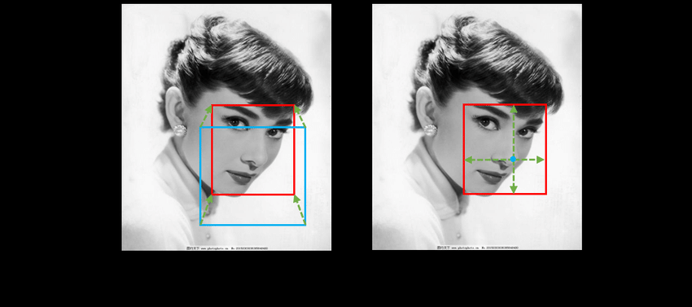
ANCHOR FREE MODEL
A visual explanation shows the difference of anchor-based and anchorfree methods.
The red bounding box is the ground truth, the blue bounding box is a predefined anchor, and the green lines are the offsets.
(a) The anchor based methods predict the offsets based on predefined anchor.
(b) The anchor free methods directly estimate the offsets of a point to its outside boundaries.

Slide 9
Why Yolov8?
YOLOv8 has a high rate of accuracy measured by COCO
COCO:
COCO (Common Objects in Context) is the industry standard benchmark for evaluating object detection models.
When comparing models on COCO, we look at the mAP value and FPS measurement for inference speed.
Models should be compared at similar inference speeds.
The YOLOv8m model -- the medium model -- achieves a 50.2% mAP when measured on COCO.
YOLOv8 comes with a CLI that makes training a model more intuitive, but other models where tasks are split across many different Python files that you can execute.

Slide 10
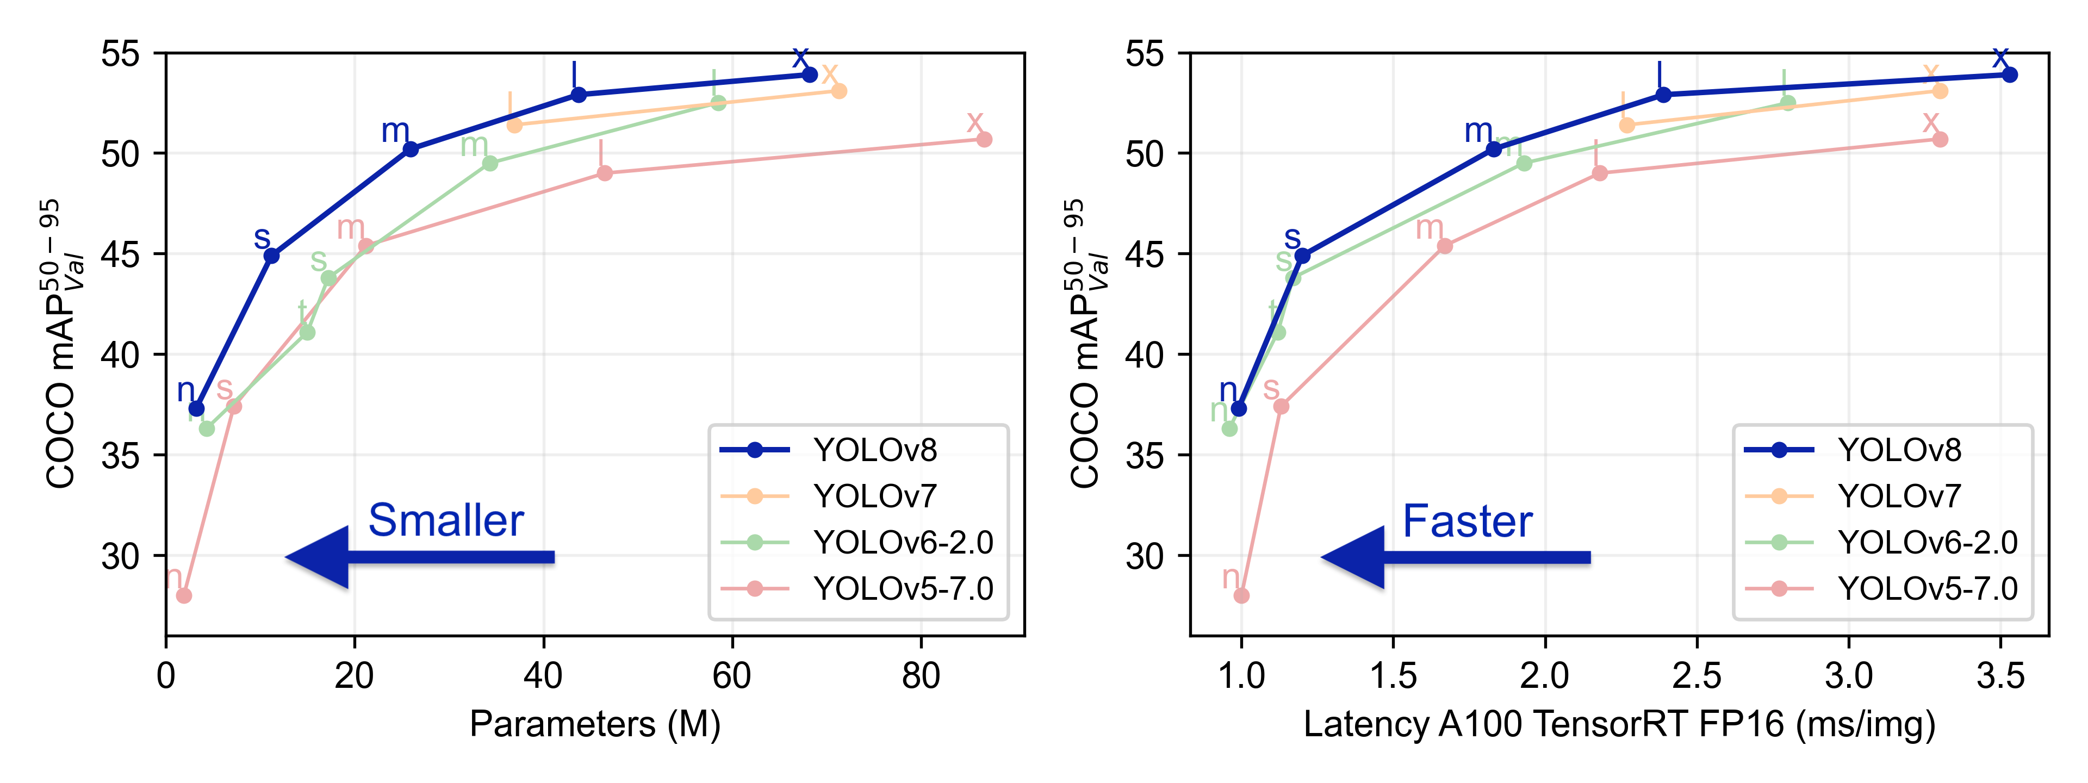
Yolo v8 compared to other versions

Slide 11
METRICS FOR EVALUATION
PRECISION AND ACCURACY
-Yolov8 has the highest map of 50.2percent.
-Map mean average precision is the combination of precision and recall
-Precision is tp/tp+fp,recall is tp/tp+fn
-TP true positive is that the model draws right box size on right object
-FP false positive draw a box on object that not supposed to be classified
-FN false negative is when there is object in image but the box is not drawn

Slide 12
DATASET USED
Images of baby crying,being normal and baby near fire.

Slide 13
REFERENCES
[1] Arjun S Kaushik, Soorya Raysam, Venkatakrishna, Dr Prabhanjan with, “Baby Monitoring System using Object Detection,” in International Research Journal of Engineering and Technology (IRJET), Bangalore, India, Aug 2020.
[2] Yogita K. Dubey, Sachin Damke, “Baby Monitoring System using Image Processing and IOT” in International Journal of Engineering Advanced Technology (IJEAT), Aug 2019.
[3] S. E. Barajas-Montiel and C. A. Reyes-Garcia, “Identifying pain and hunger in infant cry with classifiers ensembles,” in Proc. Int. Conf. Comput. Intell. Model. Control Autom. Int. Conf. Intell. Agents Web Technol. Internet Commerce (CIMCA-IAWTIC’), vol.2. Vienna, Austria, 2015.
[4]J. Redmon, S.K. Divvala, R. B. Girshick, and A. Farhadi, “You only look once: Unified, real-time object detection,” in proc. IEEE conf. Comput. Vis. Pattern Recognit. (CVPR), Las Vegas, NV, USA, 2016.
[5] Manikanta, K.P. Soman, M. Manikandan, “Deeo Learning Based Effective Baby Crying Recognition Method under Indoor Background sound Environments in 4th International conferenceon Computational Systems and Information Technology for Sustainable Solution. (CSITSS) on December 2019.

Slide 14
[6] Jiang, Z., Zhao, L., Li, S. and Jia, Y., 2020. Real-time object detection method based on improved YOLOv4- tiny.
[7] Brian McFee, Colin Raffel, Dawen Liang, Daniel P.W. Ellis, Matt McVicar in Librosa: Audio and Music Signal Analysis in Python. Proc. Of the 14th Python in Science Conference (SCIPY) 2015.
[8] Sanchez-Riera J, Srinivasan K, Hua KL, Cheng WH, Hossain MA, Alhamid MF. Robust RGB-D hand tracking using deep learning priors. IEEE Transact Circ Syst Video Technol. (2017).
[9] C. Li, Pourtaherian, W. Tjon a Ten, and P.de With, “Infant monitoring system for real-time and remote discomfort detection,” in proc. IEEE Int. Conf. Consum. Electron. (ICCE) Las Vegas, NV, USA, Jan.2020.
[10]C. Li, S. Zinger, W. E. Tjon a Ten, and P. H. N. de with, “Video- based discomfort detection for infants using a constructed local model,” in Proc. Int. Conf. Syst. Signals Image Process. (IWSSIP), Bratislava, Slovakia, May 2016.

Slide 15
THANK YOU.

